Slide 1

Data Analysis with Python
Sagar Agrawal
BCA –B
27

Slide 2
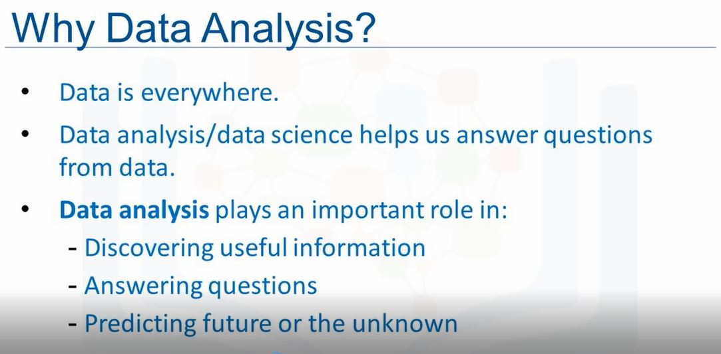

Slide 3
Scientifics computing libraries in python
1. Pandas (Data Structure and Tools)
2. NumPy (Arrays and Matrix)
3.SciPy (Integrals, Solving Differential equations ,Optimization)

Slide 4
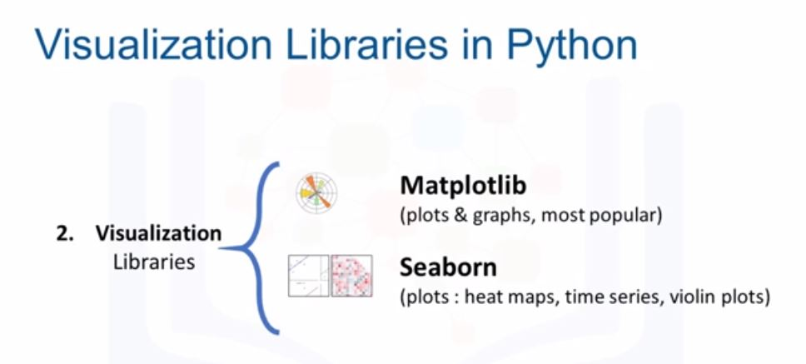

Slide 5
Topic : Data Analysis with Python On Covid-19
Importing COVID19 dataset and preparing it for the analysis by dropping columns and aggregating rows.
Deciding on and calculating a good measure for our analysis.
Merging two datasets and finding correlations among our data.
Visualizing our analysis results using Seaborn.

Slide 6
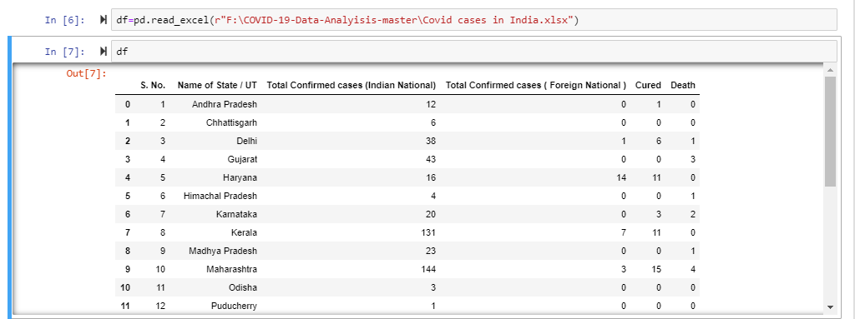
In PANDAS we use read_excel() function to read the excel file data into dataframe object.
Here we can see that df is used to represent the two dimensional tabular data structure.
Here is the tabular data of all the cases.

Slide 7
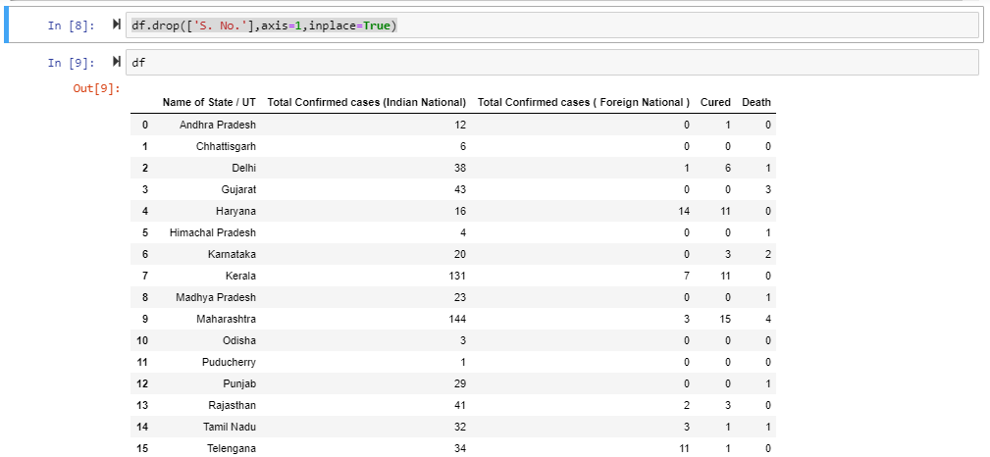
The df.drop() function Remove rows or columns by specifying label names and corresponding axis, or by specifying directly index or column names. When using a multi-index, labels on different levels can be removed by specifying the level.
As we can see that we have used ‘S. NO’ in the function i.e the 1st column has been removed from the table. Here axis is representing column and inplace =true means delete the column permanently from the table.

Slide 8
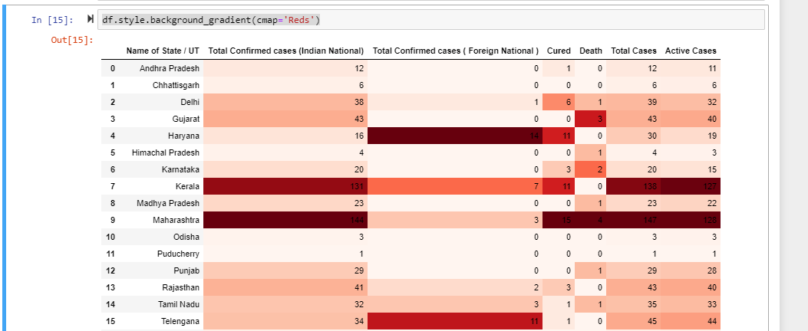
df.style()= This is a property that returns a Styler object, which has useful methods for formatting and displaying DataFrames.
background_gradient= is the background colour and cmap is the area where the colour will be filled. We can give any colour.
The darker area is showing that how the cases is increasing very crucially and the lighter area showing that the situation is still in control.

Slide 9
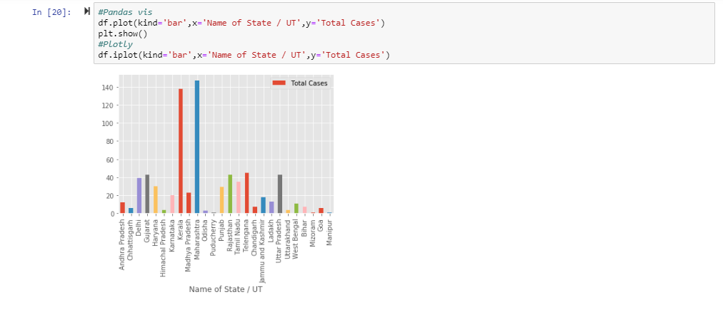
We use df.plot() function for the graphical representation and df.show() function to display the graph.
As in the previous slide we saw the darker and lighter region showing the cases now we can see the same here in the graph.
The maharashtra region has the highest number of cases in India within a short period of time.

Slide 10
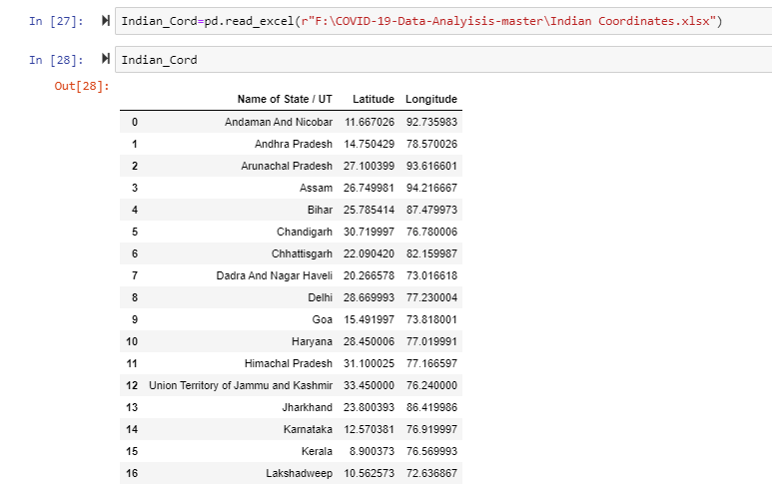
Here we took all the states and union territories with the exact location shown with latitude and the longitude.
Indian_cord is a variable that is holding the values in it.

Slide 11
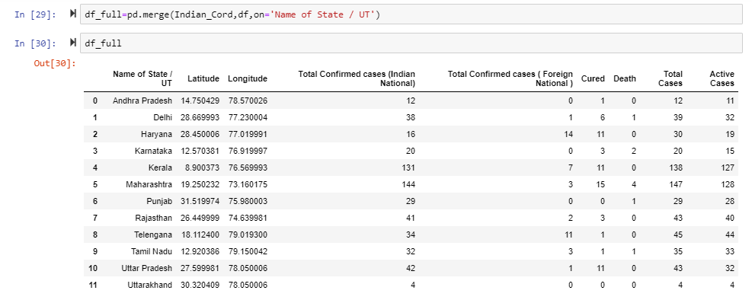
This data is to merge the state location with the cases of the corona virus that will ultimately give us that which area has the maximum number of cases in India.

Slide 12
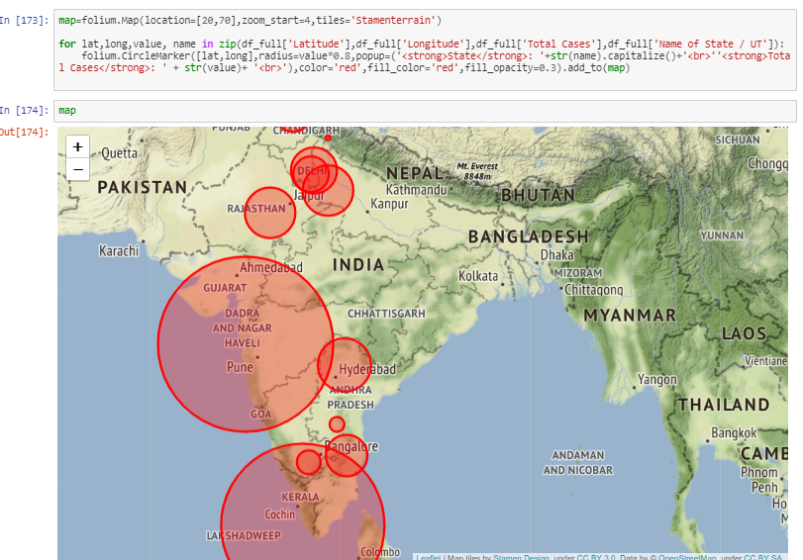
Folium()= Make beautiful, interactive maps with Python and Leaflet.js
The map representation plays a major role in presenting a project, because in this a lot of effort is not wasted and is also easy to understand. Anyone can judge the project by just having a look at it.
In this map we can clearly see that Maharashtra and Kerela and Delhi are the major paces that have the maximum number f the cases of the pandemic.

Slide 13
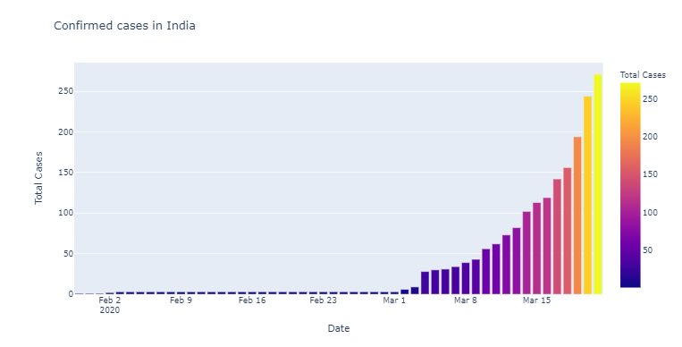
fig=px.bar(dbd_India,x="Date",y="Total Cases",color='Total Cases',title='Confirmed cases in India') fig.show()
The above code is for the colourful graphical representation of the cases in India that shows that how was the condition till march 1 and how it got increased crucially after march 1 2020.

Slide 14
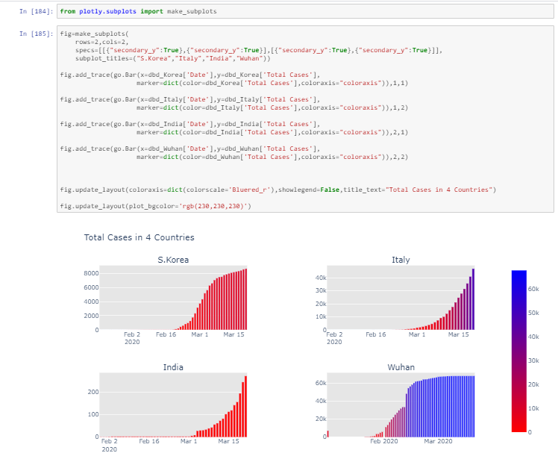
This is the overall representation of all the 4 countries that shows the total number of cases combined.

Slide 15
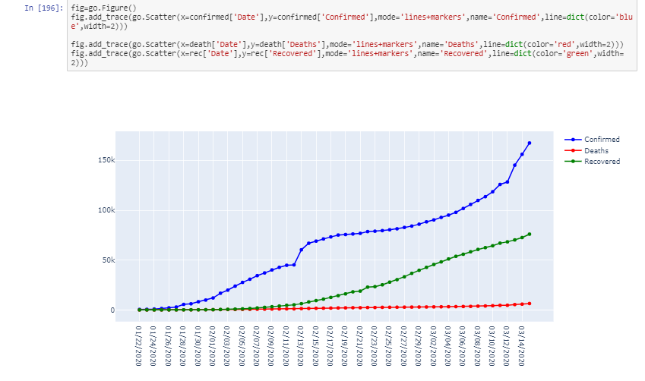
Here is the combined information of the pandemic news.
The blue line shows the confirmed cases, green shows the recovered ones and the red one shows the deaths all over the world.
This graph also shows that we do not need to worry much because the death rate is low. All we have to do is that we only need to keep our immune system strong enough to fight against it.

Slide 16
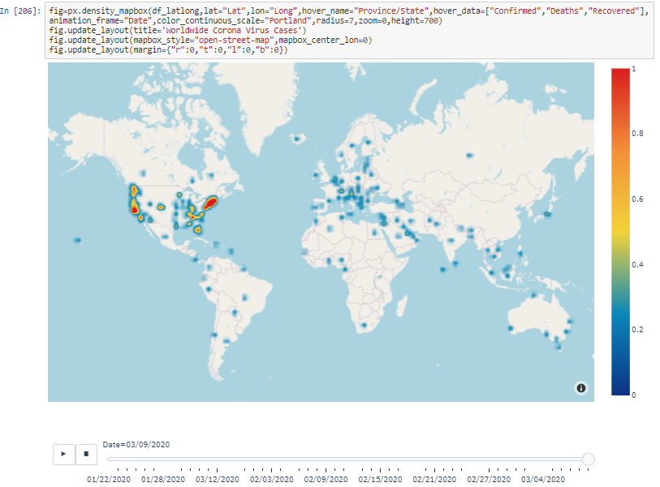
Here is the final map (the world wide map for the corona virus).
As we all know that America is now with the most cases of corona virus and death rates. So the region is having red shades. The blue shades also covers the cases and the death rates but they have are less in number.

Slide 17
Thank You

